Slide 1


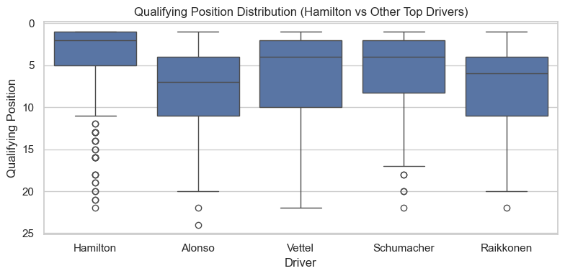
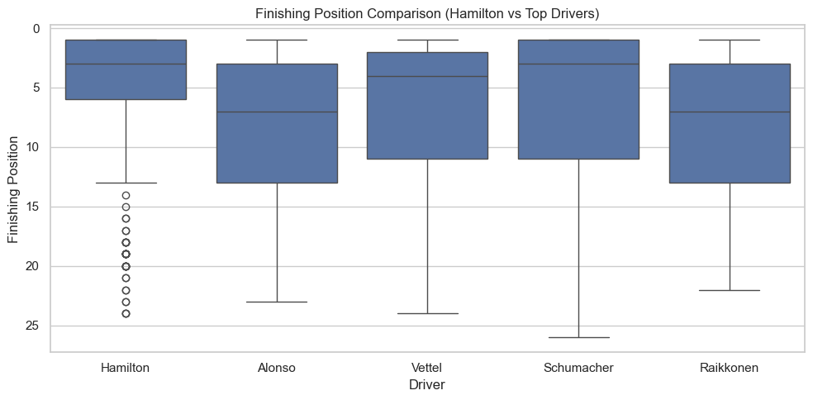
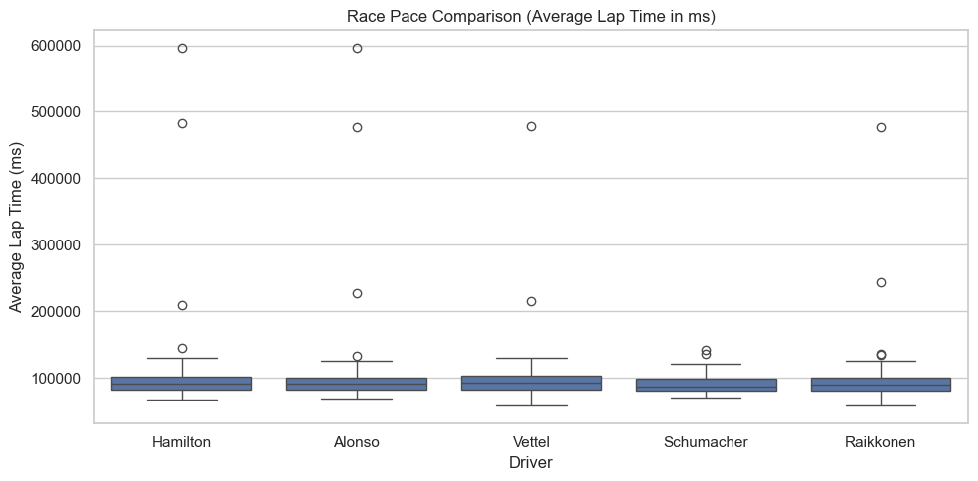
Is Lewis Hamilton the Greatest Formula 1 Driver? A Data-Driven Analysis
Tej Shah
Emory University
Abstract/Intro/Motivation
Results
Conclusions/Future Directions
Research question: Is Hamilton’s performance better than other drivers in terms of qualifying and race position and average lap times over a race?
Motivated by a long-standing interest in Formula 1.
Previous driver comparisons often focus on outcomes (driver championships) but rarely use statistics to compare factors such as consistency and race pace, which can control for externalities and determine true driver ability.
Fig 1: Qualifying Position comparison between Hamilton, Alonso, Vettel, Schumacher and Raikkonen using a side-by-side boxplot visualization
Fig 2: Final race finishing position comparison between Hamilton, Alonso, Vettel, Schumacher and Raikkonen using a side-by-side boxplot visualization
Fig 3: Race Pace comparison using average lap times between Hamilton, Alonso, Vettel, Schumacher and Raikkonen using a side-by-side boxplot visualization
What is the central research problem or question you have been helping to explore?
What work has been done previously in this area?
This section can be a review of the literature that has been most important in your research area
Qualifying: Hamilton had the best mean qualifying position (4.07) with lower variability indicating higher consistency; other drivers qualified significantly worse (Alonso +4.07, Raikkonen +3.58, Vettel +2.17, Schumacher +1.59 to Hamilton; all p < 0.001)..
Race Finishing: Hamilton achieved the best mean finishing position (5.02); competitors finished ~2-3.5 positions worse per race on average (all p < 0.001). Hamilton also showed the lowest dependence on starting grid (r = 0.244 vs. 0.31–0.52), suggesting better ability to finish first from last.
Race Pace: Average lap times were similar across drivers; no statistically significant differences in race pace relative to Hamilton.
Future Directions: Future analyses could control for team/car performance difference, examine trends for individual seasons, and apply mixed-effects models to better isolate driver skill from contextual factors.
Overall Insight: While race pace was comparable, Hamilton’s consistent advantage in qualifying and races finishes provide strong statistical evidence supporting his status as one of the greatest Formula 1 drivers.
Methods/Approach
Used publicly available Formula 1 race data spanning from 1950 to 2024.
Used the four best drivers from similar eras to Hamilton.
Three analyses were conducted:
Comparison of qualifying position using OLS regression.
Comparison of race finish position and its dependence on starting grid using regression and Pearson correlation.
Comparison of race pace by computing average lap time per race, adjusted for incomplete races with OLS regression.
Acknowledgements
Feedback and guidance from course instructor and teaching assistant was greatly appreciated.
This was part of coursework and no external funding was received.

